Slide 1

Team Name: DON'T KNOW
VisionGate AI: Automated gate triage bridging physical and digital logistics to create climate-aware, zero-idling checkpoints for smarter operations, greener ports, and seamless trade.

Slide 2
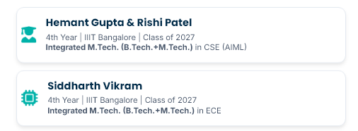

PROJECT TITLE AND TEAM INTRODUCTION
Who We Are
Core Competencies
Our diverse background allows us to tackle the physical-digital integration challenge from multiple angles:
→ Advanced AI/ML: YOLOv8 + Computer vision for damage detection, Paddle OCR+ Easy OCR for ISO reading
→ System Design: End-to-end multi-page architecture, SQLite persistence, LLM Copilot & automated PDF compliance reporting.
→ ESG & Data Intelligence : Real time CO2 tracking & sustainibility metrics, dynamic dashboards, AI grounded copilot insights.
"Our Philosophy: We build bridges. VisionGate AI connects siloed systems by uniting domain knowledge with cutting-edge engineering."
→ Supply Chain Strategy: Automated BoxBay routing, gate optimization & labor cost elimination for port operators.

Slide 3

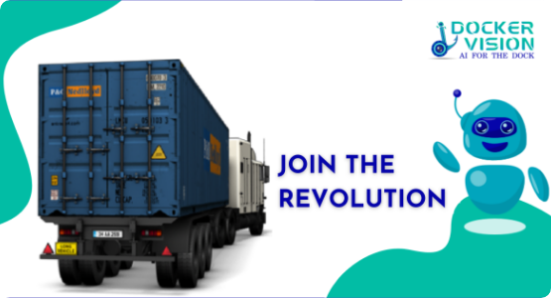
PROBLEM STATEMENT
Problem Understanding: Clearly identifies gate congestion, truck idling emissions, and human error in manual container inspection.
Domain: Port & Terminal Operations & Supply Chain Visibility.
The Target User: Gate Inspectors, Yard Planners, Customs Brokers.
The Pain Today (Bottleneck)
Gate is the biggest bottleneck; 5+ min manual checks per truck.
3-5% manual data entry errors causing massive congestion.
Dangerous hazardous carbon leaks as a result of queueing
Queuing accounts for 30% of localized emissions
We replace slow clipboards with instantaneous, tech-agnostic Computer Vision.

Slide 4


PROPOSED SOLUTION/SOLUTION OVERVIEW
An intelligent, technology-agnostic platform converting standard CCTV feeds into an autonomous AI pipeline, modernizing DP world's global gate infrastructure.
Structural and Thermal
Cargoes Copilot
One click Audit Reports
Computer vision extracts information from containers and docs and identify structural and thermal shortcomings at various DP world ports while suggesting further action.
User can ask queries in natural language, an AI chat model converts it into SQL query. Furthermore, user can upload documents to provide additional context to queries.
Instantly export legally defensible PDF gate audits from the live database. Seamlessly share audit-ready evidence with customs and freight forwarders.
Handling Congestion
Metric Tracking
Weather Aware Cargo
Decisions
VisionGate constantly keeps track of ship delay schedule from controllers and notify truck drivers or next step delivery agents to avoid congestion of too many vehicles at once on the port.
Real time multi metric tracking providing insights about bottle necks and shortcomings. This includes container health and ship delay distribution data.
Some containers that have a few structural faults cannot be transferred to ports with certain climates. We are handling that by suggesting what ports cannot be used to transfer certain cargo.

Slide 5
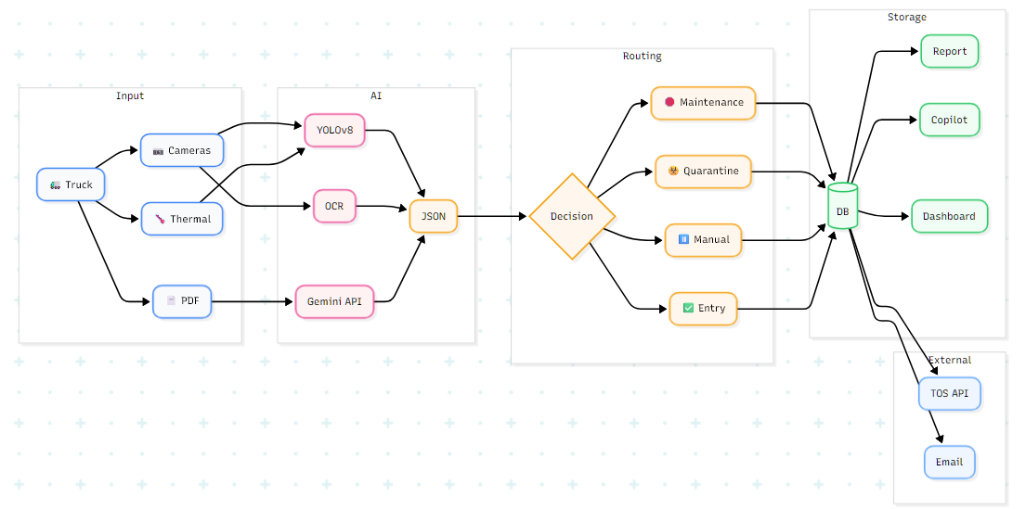
PROPOSED SOLUTION/SOLUTION OVERVIEW
END-TO-END ARCHITECTURE

Slide 6


TECHNOLOGY STACK PROPOSED
ML / AI Perspective
SDE Perspective
Computer Vision Frameworks: PyTorch / TensorFlow, OpenCV (image pre-processing).
Object Detection (Damage): YOLOv8 / YOLOv10 (Trained on custom Roboflow container datasets).
Text Extraction (OCR): PaddleOCR (Optimized for edge-deployment text-in-the-wild).
Conversational AI: Gemini API
LLM Orchestration: LangChain or LlamaIndex (to connect the LLM to the PostgreSQL database, allowing the AI to query realtime container statuses).
Inference Optimization: NVIDIA TensorRT (to accelerate CV model processing times).
Frontend: React.js / Next.js (or Streamlit for rapid prototyping), TailwindCSS for responsive UI, WebSockets (for real-time chat Assistant updates), jsPDF (for generating downloadable compliance reports).
Backend Server: Python (FastAPI/Uvicorn) for high-performance, asynchronous RESTful API endpoints.
Database (RDBMS): PostgreSQL (Master-Slave architecture for read/write splitting), B-Tree Indexing on ISO container codes.
NoSQL / Caching: Redis (to cache frequent LLM queries and reduce latency).
Message Broker: Apache Kafka (to handle spikes in truck arrivals, decoupling image ingestion from DB writes).
Infrastructure & DevOps: Docker (containerizing microservices), Kubernetes (K8s) for horizontal pod scaling, Nginx (Reverse Proxy & Load Balancing), AWS S3 (for durable image blob storage), AWS EC2/EKS.

Slide 7

BASIC PROTOTYPE
Bridging the Gap: VisionGate AI eliminates the silos between Truck Drivers, Port Operators, and Customs.
DP World Ecosystem Integration
Technology-Agnostic Setup
Designed to plug directly via API into DP World’s CARGOES TOS (Terminal Operating System) and Zodiac.
Acts as the unified "Entry API" for physical goods entering the DP World digital ecosystem.
No proprietary hardware required. Implementation is software-first for rapid global deployment.
Works with any standard IP/RTSP camera setup currently installed at DP World facilities globally.
Logistics & Freight Forwarding
Metric Tracking
Eliminates the industry standard 3-5% manual data entry error rate.
Provides forwarders with true real-time visibility the exact second a truck hits the port gate.
Auto-generates immutable PDF audit trails.
All operational constraints are measured under various metrics to determine data point distributions. This helps to suggest areas of improvement

Slide 8
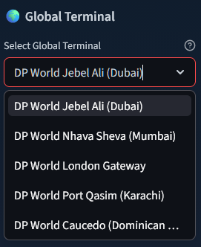
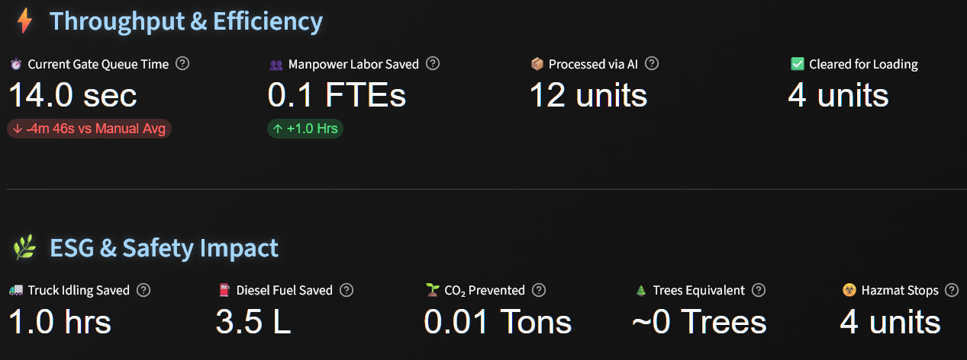
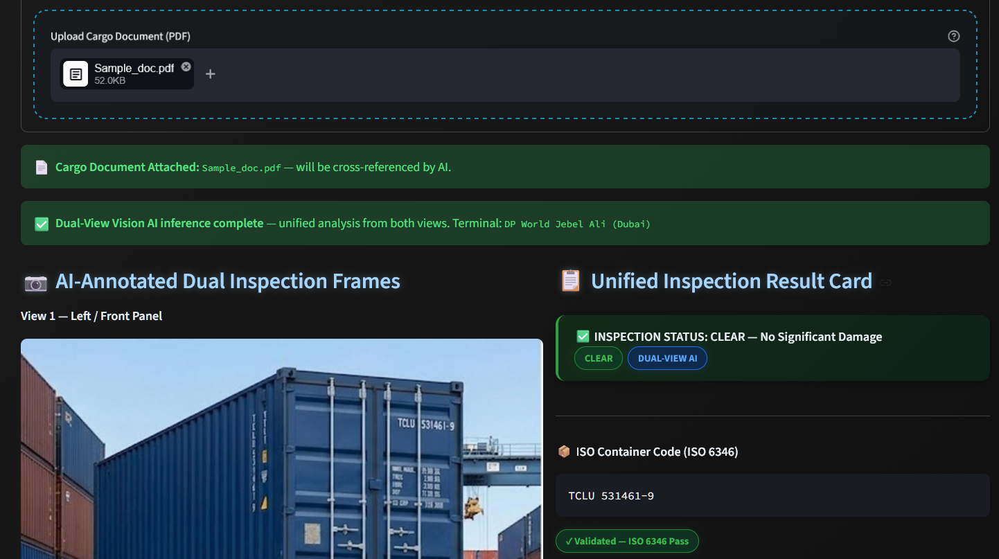
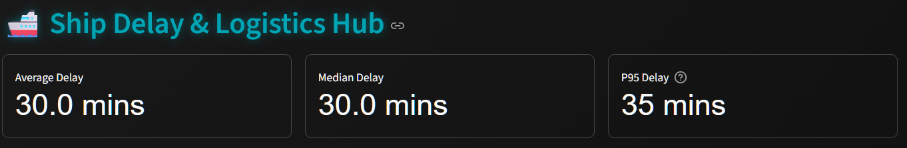
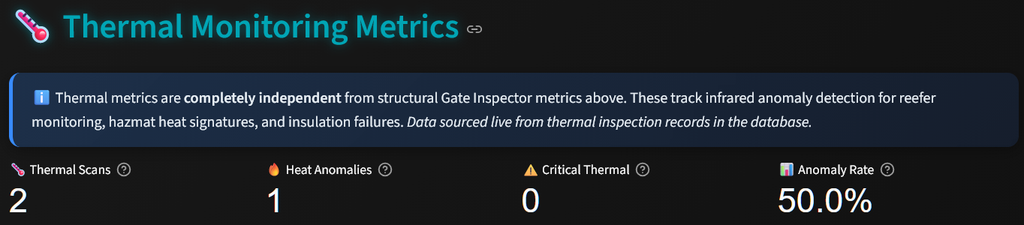
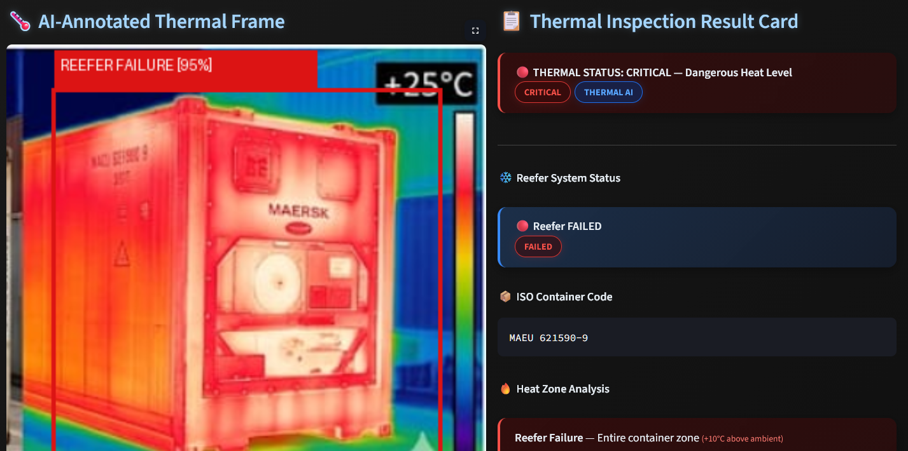
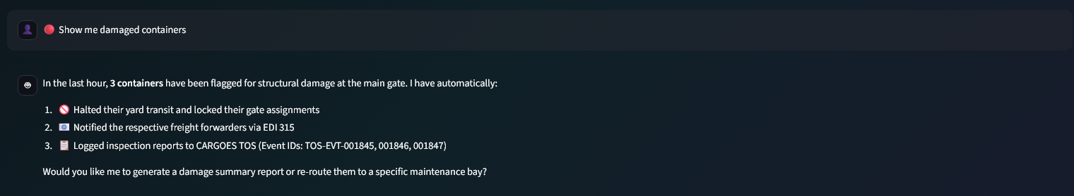
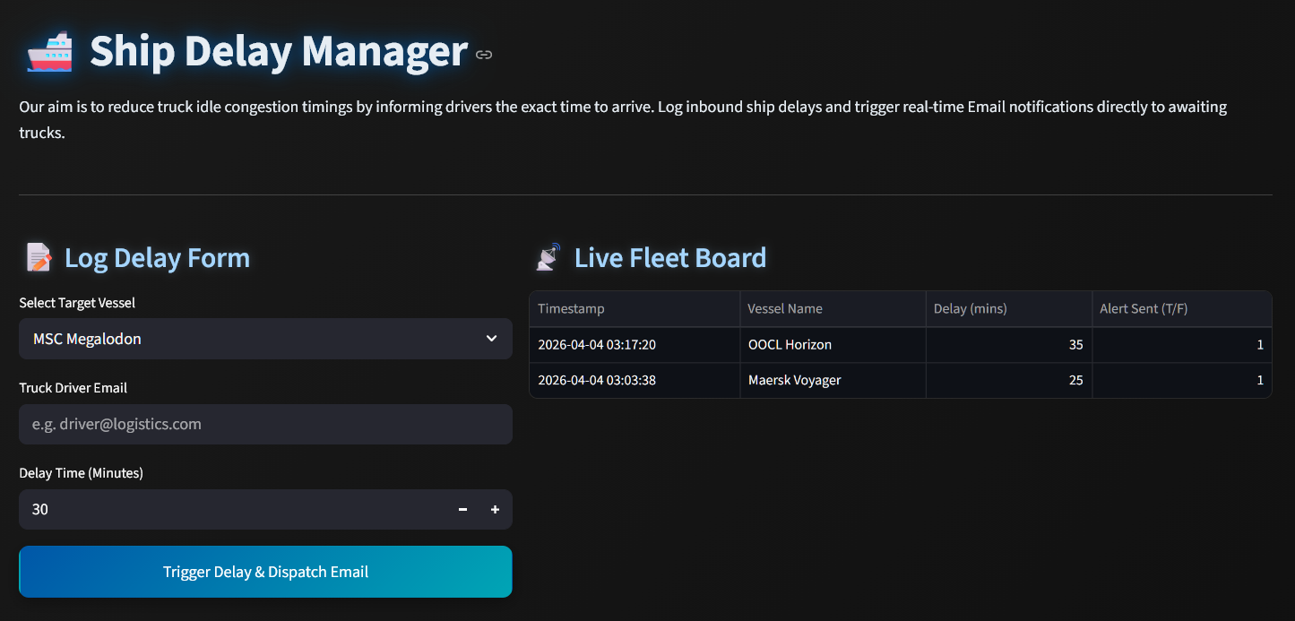
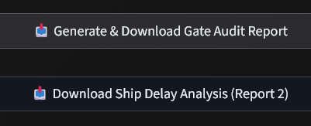
PROTOTYPE SNIPPETS & VIDEO DEMO
Container Inspection Analysis with Thermal Image Support
Supporting Multi-Geography
Complete Dashboard: Supporting Sustainability Conscious
VIDEO DEMO
(CLICK PLEASE)
GitHub
AI Chat with PDF upload support
Ship Delay Management
Downloadable Reports

Slide 9
MARKET ANALYSIS & ESG ALIGNMENT
Market Analysis
Sustainability Conscious & ESG Compliance
Total Available Market – Majority market share is in Port automation and automated container terminal market. Taking relevant approximations, TAM is measured to be 10 Billion USD with combined CAGR of 9.2 percent.
Based on segmentation, 55 percent of available market is software/services, and accounting for the fact that some ports are more conserved about their approaches, we can estimate Servicable Available Market(SAM) to be 4 billionUSD with the same 9.2 CAGR.
Targeting Asian and Middle East ports first, we can realistically obtain an early-stage market share of 200-500 million USD.
Reuters has conducted a study that shows that carbon emissions can be effectively reduced in logistics using AI tools.
From a Governance standpoint, this solution moves towards higher traceability, which will lead to better compliance systems
Multi-Geography
AI Assistant allows a Dubai user to query in Arabic while a driver receives automated Hindi text instructions.
Support of multiple ports across different countries

Slide 10
BUSINESS CASE
Value Proposition
Revenue Model
Inspection Time: Huge value of this solution lies in decreasing inspection time, our OCR and thermal imaging analysis completely eliminates human intervention from commercial cargo inspection.
Inspection Costs: We are saving 30-40 minutes per inspection, considering medium frequency port with 2000 containers per day with the industry standard inspection rate of 10 percent at random. We save upto 117 man hours everyday. Considering workforce employees work 8 hours everyday, port can work on same efficiency with 14 workers less on average.
Decision accuracy: The feature that assigns cargo issues to which ports it shouldn't be assigned to according to pre-defined data saves a lot of operational costs that comes from not considering cargo issues at ports. Even if 1 percent of slightly degraded cargo gets affected from this, we can be looking at goods worth millions of dollars as a cost save.
Basic Revenue Model: Vision Gate AI will follow a SaaS plus enterprise hybrid revenue model.
Subscription Model: Outsourcing the products to non DP world ports, charging them an annual premium based on number of terminals and predicted container volume.
Usage Based Pricing: For ports with wildly varying activity, a usage based service can be provided based on API usage, or container volume in that period and not a fixed annual licence fee.
Enterprise model: Some more specific customers can get separate fine tuned models for their use cases while maintaining the generic architecture. Like a port with narcotic delivery activity might utiilise risk score to conduct better investigations. So the model can have a higher weight to certain factors.

Slide 11


INNOVATIVE ASPECTS
Beyond Dashboards
Actively Reducing Costs
Connecting Silos
Most logistics software requires 10 menus; our innovation provides one stop solution for port metric analysis. Workers speak naturally to the system; the system uses CV to see the real world with zero learning curve.
Vision Gate actively works to reduce small costs around port solutions optimising management lifecycle. Reducing inspection cost is a huge step towards moving to new naval logistic practices.
Seamlessly connects the physical truck driver's reality with the congestion management module. This makes sure a huge bottleneck for both last mile delivery delay and vehicle operational cost is handled.
Cross-Discipline Synthesis
Technology-Agnostic
We combined Software Engineering (scalable APIs), Domain Knowledge (ISO 6346 standards, gate workflows), and Business Thinking (CAPEX reduction, ESG compliance) into one platform.
We do not require DP World to buy proprietary smart-cameras. Our solution layers over any existing RTSP camera feed, dramatically lowering the barrier to entry and proving we solve the problem, not just push a technology.

Slide 12


Thank You!
Future Roadmap
PHASE 1: ADDITIONAL FEATURES
PHASE 2: SCALABILITY PRACTICES
Build a dedicated ship database for a flexible, scalable architecture
Integrate MarineTraffic APIs for trade route analysis and cargo-based recommendations
Use optimization models to allocate ship space based on risk and availability
Enable encrypted continuous video streaming to prevent tampering
Perform container inspection at entry and exit to detect port-related damage
Deploy ML models to assign risk scores, triggering deeper inspection for high-risk containers
Extend to General Cargo
Migrate from SQLite to PostgreSQL for write-heavy workloads and horizontal scaling
Implement master–slave architecture for high availability
Use Kafka to decouple API and database, reducing peak-time request drops
Cache LLM responses with Redis
Add edge layer for offline port operations with later sync to central DB
Prioritize AP mode at edge nodes, AC at the central server
Use Amazon S3 as a vector database for document storage and LLM-based retrieval

